Slide 1
Kiki

Slide 2






Team Presentation
Jose Manuel
Fonseca
Maria Paulina Ocampo
Simón Marín
Mauricio
Toro

Slide 3


Slide 4
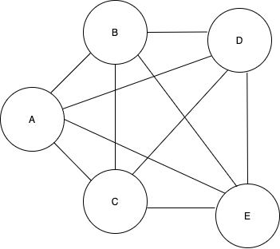

Data Structures
Figure 1: We use an undirected graph to represent a map where the client and the station will be shown. Each node contains a client and a station.
Figure 2: An arraylist to save the routes. Each route contains the distances

Slide 5

Algorithm Design
1.
20
10
1
5
10
2
This image illustrates how a given a graph (this decision represented by a tree)chooses the path based on the closest node from the perspective of the actual node.

Slide 6
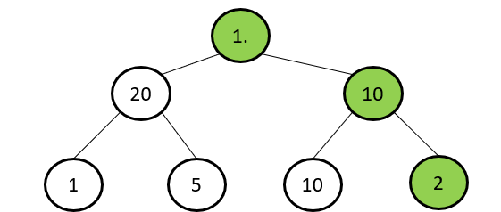
Path choosing
Time= 20 minutes
1.
2
3
6
5
7
7
3
4
6
4
4
2
3
5
4
2
5
3
The program will find the closest route, but the problem comes when we pick one node, we don’t know which nodes were picked in the past.
Now we don’t only take into account the closest, but also the time and the time going back.

Slide 7
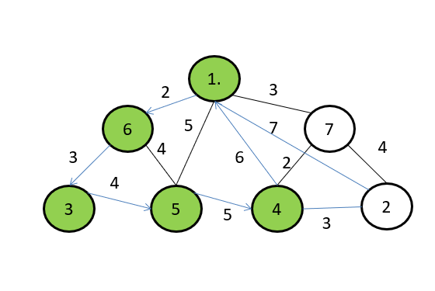
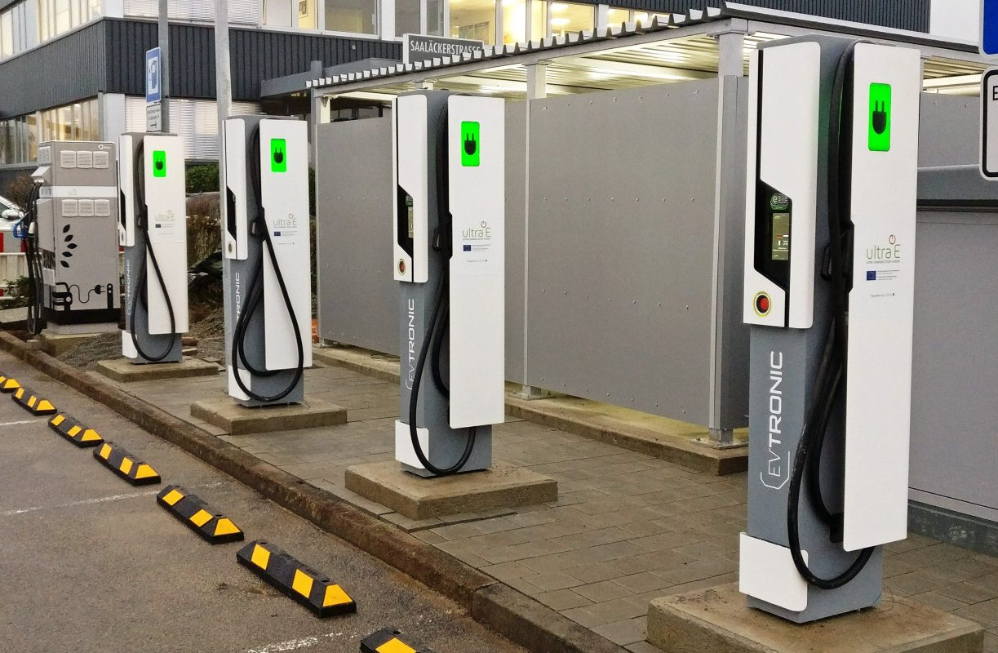


Battery life
CC
Most Relevant Feature
English
Fun Fact
The relevant features changes every time with random forest
When it comes to delivery, another variable appears which is the fuel or in this case charge of the delivery vehicles.

Slide 8

Battery life
The question that arises due to the battery problem is, in what moment do we charge the car considering the distance of the charging node? What percentage is ideal to charge?

Slide 9

Algorithm and Complexity
Subproblems | Complexity
Create the graph | O(n)
Check which nodes are left to visit | O(m)
Find the shortest distance from one node | O(m)
Total complexity | O(n+m²)
Figure 2: optimal choice of cost in greedy algorithm
Table 1: Complexity of each subproblem that is part of the algorithm. Let n be the amount of nodes, m the number of clients.

Slide 10
Time and Memory Consumption
 | Dataset 1 | Dataset 2 | Dataset 3 | Dataset 4
Best case | 0.004 s | 0.004 s | 0.004 s | 0.004 s
Average case | 0.00705 s | 0.00676 s | 0.00655 s | 0.00636 s
Worst case | 0.016 s | 0.014 s | 0.014 s | 0.015 s
Table 2: Execution time of the data structure for different datasets.

Slide 11
Time and Memory Consumption
 | Dataset 1 | Dataset 2 | Dataset 3 | Dataset 4
Memory usage | 1.597 MB | 1.596 MB | 1.596 MB | 1.596 MB
Table 2: Memory consumption of the data structure for different datasets.

Slide 12
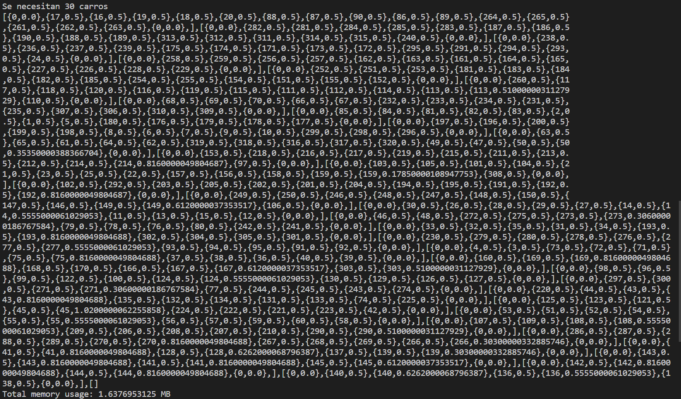
Software prototype
Figure 4:Solution for optimal routing

Slide 13


